Slide 1
Marks2CSV
A simple solution to convert tabular mark fields to CSV file
Mini Project Presentation: First Review
Guided by:
Dr. Deepa V.
Presented by:
Ajay T Shaju, SJC20AD004
Emil Saj Abraham, SJC20AD028
Justin Thomas Jo, SJC20AD046
Vishnuprasad K G, SJC20AD063
Artificial Intelligence & Data Science Mini Project: ADD334 24th April 2023 1/20
Notes:
Work done after zeroth review

Slide 2
Outline
Introduction
Problem Statement
Application
Literature Survey
Block Diagram
Data Collection
Work Done So Far
Performance Evaluation
Work To Be Done
Conclusion
References
Artificial Intelligence & Data Science Mini Project: ADD334 24th April 2023 2/20

Slide 3
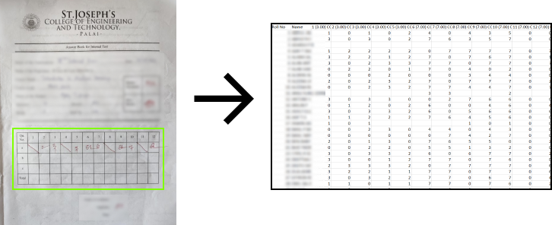
Introduction
Idea: Answer sheet marks to CSV File.
Saves time and resources.
Reduce errors.
Artificial Intelligence & Data Science Mini Project: ADD334 24th April 2023 3/20
Notes:
●Save time and resources - resources in the sense, productivity of our teachers
●Reduce errors - To a great extend, bcz we used a NN trained on 1000s of image data

Slide 4
Problem Statement
Manual data entry is a labor-intensive process that requires significant time and effort.
Prone to errors
Inaccurate data
Loss of valuable time
This project aims to develop an automated solution that streamlines the aforementioned problems.
Artificial Intelligence & Data Science Mini Project: ADD334 24th April 2023 4/20
Notes:
We know that man data entry is a tedious & Labor intensive process,

Slide 5
Application
Detection of handwritten marks from images and their conversion into CSV format.
Simplify the mark data entry process by avoiding manual input of marks on each cell.
Final output as a CSV file comprising all numbers extracted from the input images.
Automated generation of mark list saves time.
Designed specifically for SJCET Teachers.
Artificial Intelligence & Data Science Mini Project: ADD334 24th April 2023 5/20

Slide 6
Literature Review
OCR,artificial intelligence,document scanning,machine learning,image recognition.
Increased speed and efficiency, improved accuracy, reduced costs and increased accessibility.
Gap - recognition accuracy of complex data structures is poor.
Future scope - impact of OCR increases as technology advances, thereby giving more importance and emphasis to using it in businesses and organizations.
[1] A.Raj, S.Sharma, J.Singh, A.Singh, “Revolutionizing Data Entry: An In-Depth Study of Optical Character Recognition Technology and Its Future Potential”, International Journal for Research in Applied Science & Engineering Technology, Vol. 11 No.2, pp: 645-653, Feb 2023.
Artificial Intelligence & Data Science Mini Project: ADD334 24th April 2023 6/20
Notes:
.Improved characteristics for the model proposed.
Accuracy for simpler data structures are significantly satisfiable.

Slide 7
OCR classification and image processing with use of Naive Bayes algorithm.
Identification of text from handwritten documents, extracting features and training them.
Gap - accuracy is only 53%, lack of implementation of better model.
Future scope - apply same method with a neural network.
[2] Ömer Aydin, “Classification of Documents Extracted from Images with Optical Character Recognition Methods”, Anatolian Journal of Computer Sciences, Vol.6 No.2 pp:46-55, 01 Jun, 2021.
Artificial Intelligence & Data Science Mini Project: ADD334 24th April 2023 7/20
Notes:
Using Naive Bayes algorithm yields only under average accuracy.
Prefer neural network.

Slide 8
[3] Raajkumar G., Indumathi D., “Optical Character Recognition using Deep Neural Network”, International Journal of Computer Applications, Vol. 176 No. 41 pp:61-65, July 2020.
Image processing, OCR model, long short term memory.
Related work - text and image segmentation, CNN.
Gap - cannot identify text set at a particular angle.
Future scope - implies more usage of PyTesseract over SVM.
Artificial Intelligence & Data Science Mini Project: ADD334 24th April 2023 8/20
Notes:
If camera is not kept at said angle, the OCR tool could malfunction.
Pytesseract > SVM

Slide 9
Optical character recognition,classification,languages,feature extraction,deep learning.
Implementation of MLP, use of datasets like CEDAR,MNIST,CHARS74K.
Gap - Publicly available datasets also include stimuli that are aligned well with each other and fail to incorporate examples that correspond well with real-life scenarios, i.e. writing styles, distorted strokes, variable character,thickness and illumination.
Future scope - implementation of deep learning architectures like CNN,RNN and LSTM will steadily increase.
[4] J.Memon, R.Sami, Rizwan A.Khan, M.Uddin, “Handwritten Optical Character Recognition (OCR): A Comprehensive Systematic Literature Review (SLR)”, IEEE Access, Vol. 8, pp:142642-142668, 2020.
Artificial Intelligence & Data Science Mini Project: ADD334 24th April 2023 9/20
Notes:
MLP - Multilayer Perceptron.
Datasets - MNIST, CHARS74K
Different style of handwriting, distortion, thickness variation

Slide 10
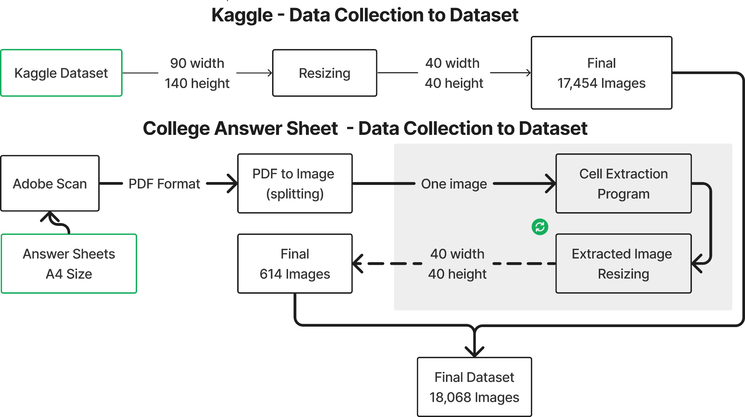
Block Diagram
Artificial Intelligence & Data Science Mini Project: ADD334 24th April 2023 10/20

Slide 11
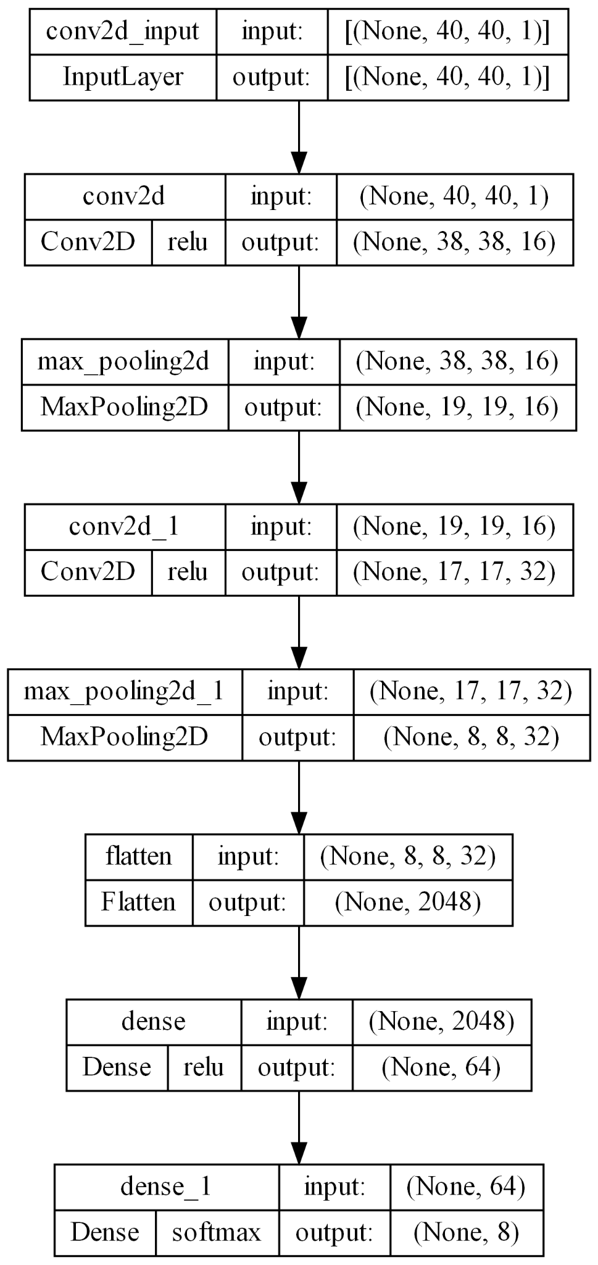
Block Diagram
Neural Network Architecture
Artificial Intelligence & Data Science Mini Project: ADD334 24th April 2023 11/20
Notes:
2 Hidden layers – conv + max pooling
None is the batch size, it is 32 in our case but in keras it is defaults to None, so that we could have a flexibility in batch size

Slide 12
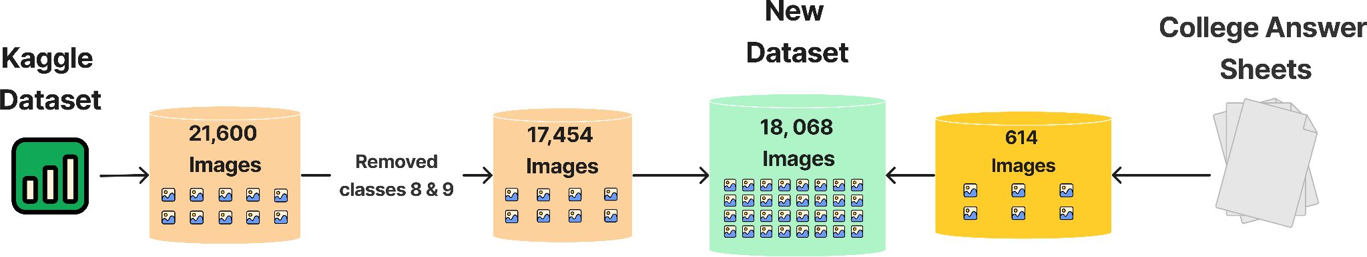
Data Collection
Artificial Intelligence & Data Science Mini Project: ADD334 24th April 2023 12/20
Notes:
Even with a good amount of manual work we could collect very little amount of our dataset

Slide 13
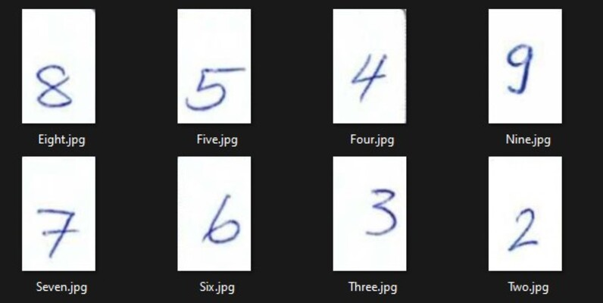
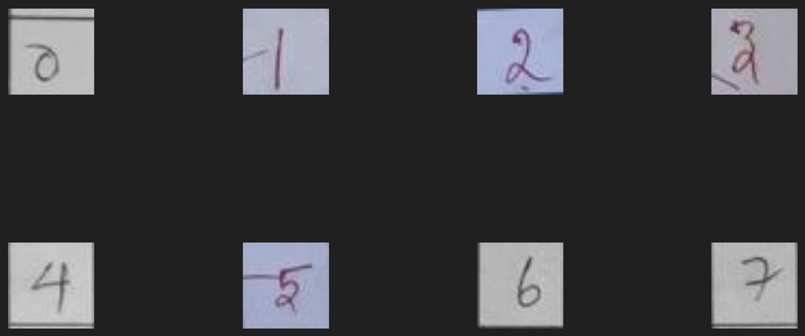
Work Done So Far
Used a library ‘img2table’ for detecting and extracting cells.
Created dataset using an online handwritten dataset & images from answer sheets.
Online Dataset Header Image
Answer Sheet Dataset Sample Images
Artificial Intelligence & Data Science Mini Project: ADD334 24th April 2023 13/20
Notes:
Done 3 works - cell extraction, dataset creation, and building a neural network.

Slide 14
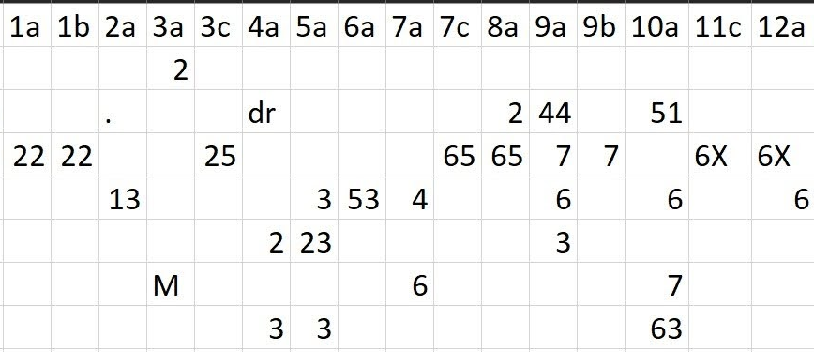
Mistakes in Paddle OCR predictions.
Created neural network for number detecting (Custom OCR tool).
Output of Paddle OCR tool
Artificial Intelligence & Data Science Mini Project: ADD334 24th April 2023 14/20
Notes:
●Convert values in image to digital text,
●we used easyOCR, PyTesseract & Paddle OCR
●Paddle gives a result, but predictions were poor
●So we planned to make a network

Slide 15
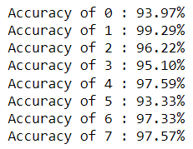


Performance Evaluation
Neural Network Accuracy
Time taken for Prediction
Prediction Accuracy
Artificial Intelligence & Data Science Mini Project: ADD334 24th April 2023 15/20

Slide 16
Work To Be Done
Collect more datasets
Analyze model performance using additional methods
Integrate custom OCR tool
Preprocess DataFrame
Physical equipment for holding the camera
Artificial Intelligence & Data Science Mini Project: ADD334 24th April 2023 16/20
Notes:
●More data means more learning
●Precison, recall etc..
●Now we’re using paddle ocr, remove paddle & integrate our custom ocr
●Remove unwanted rows & columns
●Phy equip for real time capturing, we get more aligned pictures

Slide 17
Conclusion
Dataset consist of 18,068 Images
Testing accuracy of CNN is 95.81%.
Custom OCR tool has achieved greater accuracy than previous OCR tool(Paddle OCR).
Artificial Intelligence & Data Science Mini Project: ADD334 24th April 2023 17/20

Slide 18
References
[1] A.Raj, S.Sharma, J.Singh, A.Singh, “Revolutionizing Data Entry: An In-Depth Study of Optical Character Recognition Technology and Its Future Potential”, International Journal for Research in Applied Science & Engineering Technology, Vol. 11 No.2, pp: 645-653, Feb 2023.
[2] Ömer Aydin, “Classification of Documents Extracted from Images with Optical Character Recognition Methods”, Anatolian Journal of Computer Sciences, Vol.6 No.2 pp:46-55, 01 Jun, 2021.
[3] Raajkumar G., Indumathi D., “Optical Character Recognition using Deep Neural Network”, International Journal of Computer Applications, Vol. 176 No. 41 pp:61-65, July 2020.
[4] J.Memon, R.Sami, Rizwan A.Khan, M.Uddin, “Handwritten Optical Character Recognition (OCR): A Comprehensive Systematic Literature Review (SLR)”, IEEE Access, Vol. 8, pp:142642-142668, 2020.
[5] Colin G.White-Dzuro, Jacob D.Schultz, C.Ye,Joseph R. Coco, Janet M. Myers, C.Shackelford, S.T.Rosenbloom,D.Fabbri, “Extracting Medical Information from Paper COVID-19 Assessment Forms”, Applied Clinical Informatics Vol. 12 No. 1, pp:170–178, 2021.
Artificial Intelligence & Data Science Mini Project: ADD334 24th April 2023 18/20
Notes:
Don’t go into the details of these too much
You are welcome to brief a little about [5]

Slide 19
Questions?
Artificial Intelligence & Data Science Mini Project: ADD334 24th April 2023 19/20
Notes:
Frame questions that can be expected and put them on another slide, to prepare us to face any type of queries.
Don’t stutter or remain silent, make sure to continue the flow.

Slide 20
Thank You
Artificial Intelligence & Data Science Mini Project: ADD334 24th April 2023 20/20

Slide 23
Presentation Setting
Introduction – Ajay
Problem statement – Ajay
Application – Emil
Literature Survey – Justin
Block Diagram – Justin
Data Collection – Vishnu
work done so far – Ajay
performance evaluation – justin
Work To Be Done– Emil
Conclusion – Vishnu
References – Vishnu
Don’t Present this
Don’t Present this

Slide 24
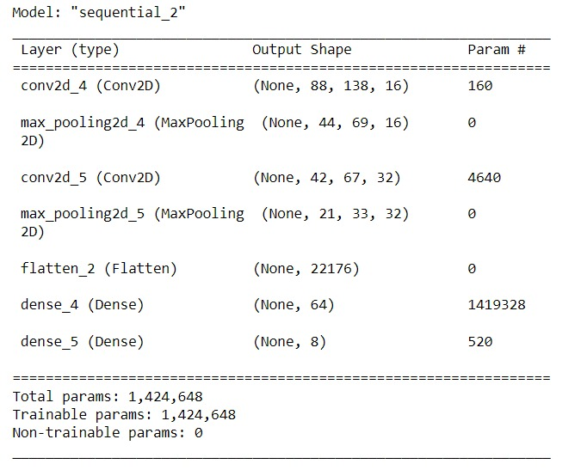
Custom OCR Model Summary
Artificial Intelligence & Data Science Mini Project: ADD334 24th April 2023 14/20

Slide 25
Conclusion
Ensure that the predictions are accurate need to improve the accuracy further.
need to integrate the table detection algorithm & a custom OCR model.
aim to reduce the time taken by teachers to do the mark data entry procedure.
Preliminary results has yielded great success but can still be improved.
Validation accuracy of CNN is 95.81%.
Artificial Intelligence & Data Science Mini Project: ADD334 14th March 2023 17/20

Slide 26
Data Description
Excluded
May be useful in future
Primary data are ‘Answer sheets of our college’, which are image data of A4 size
The data comes under ‘college documents’ domain
Initial data can be collected from our department, for more data variability, we could request it from other departments of our college itself.
Data can be compressed to file format like PDF for easy portability
Data size: Input data can have 5-10MB (PDF), and output data can have 4KB - 2MB (CSV)
Data may be unstructured and papers may be damaged or faded.

